Slide 1
Systems Analysis and Design 10th Edition
Chapter 7
Development Strategies

Slide 2
Chapter Objectives
Describe the concept of Software as a Service
Define Web 2.0 and cloud computing
Explain software acquisition alternatives, including traditional and Web-based software development strategies
Describe software outsourcing options, including offshore outsourcing and the role of service providers

Slide 3
Chapter Objectives (Cont.)
Explain advantages and disadvantages of in-house software development
Discuss cost-benefit analysis and financial analysis tools
Describe a request for proposal (RFP) and a request for quotation (RFQ)
Describe the system requirements document
Explain the transition from systems analysis to systems design

Slide 4
Development Strategies Overview
A few years ago
Companies either developed software in-house or purchased a software package
Hired consultants to perform the work
Today, a company has many more choices:
Application service providers
Web-hosted software options
Firms that offer enterprise-wide software solutions
Companies must deal with the impact of the Internet, software outsourcing options, and in-house software development alternatives

Slide 5
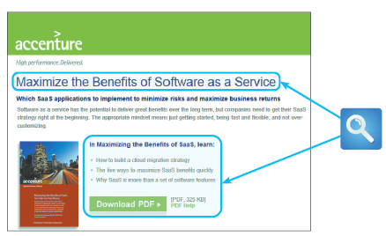
Development Strategies Overview (Cont.)
The Impact of the Internet
Software as a Service
Software as a Service (SaaS)
Prediction by Gartner, Inc.:
Worldwide SaaS revenue will reach $14.5 billion in 2012, which is a 17.9 percent increase from 2011, and that by 2015, SaaS revenue will grow to $22.1 billion
FIGURE 7-2 Accenture stresses the main benefits of SaaS deployment

Slide 6
Development Strategies Overview (Cont.)
Traditional vs. Web-Based Systems Development
Traditional Development
System design is influenced by compatibility issues
Systems are designed to run on local and wide-area networks
Systems often utilize Internet links and resources
Web-based features are treated as enhancements rather than core elements of the design
Development typically follows one of three main paths:
In-house development
Purchase of a software package with possible modification
Use of outside consultants
Scalability affected by network limitations and constraints
Many applications require substantial desktop computing power and resources
Security issues usually less complex than Web-based systems

Slide 7
Development Strategies Overview (Cont.)
Traditional vs. Web-Based Systems Development
Web-Based Development
Systems are developed and delivered in an Internet-based framework such as .NET or WebSphere
Treats the Web as the platform, rather than just a communication channel
Easily scalable, and can run on multiple hardware environments
Used for customer relationship management, order processing, and materials management
Treats the software application as a service that is less dependent on desktop computing power and resources
Limits in-house involvement to a minimum as vendors install, configure, and maintain the system
Requires additional layers, called middleware, to communicate with existing software and legacy systems

Slide 8
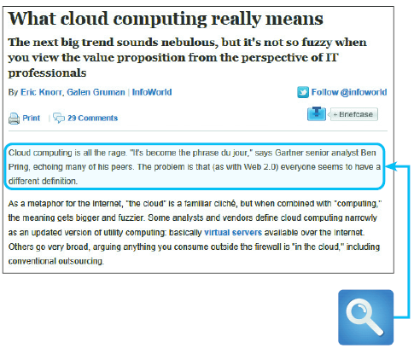
Development Strategies Overview (Cont.)
Evolving Trends: Web 2.0 and Cloud Computing
Web 2.0 will enhance interactive experiences
Wikis and blogs
Social networking
Cloud computing may offer an overall online software and data environment
FIGURE 7-5 Cloud computing holds the promise of a new generation of powerful Web applications and services. This is an evolving technology, and at this point, the term means different things to different people

Slide 9
Outsourcing
The Growth of Outsourcing
A firm that offers outsourcing solutions is called a service provider
Application service providers (ASP)
A firm that delivers a software application, or access to an application, by charging a usage or subscription fee
Internet business services (IBS)
Also called managed hosting
Web-based support for transactions such as order processing, billing, and customer relationship management

Slide 10
Outsourcing (Cont.)
Outsourcing Fees
A fixed fee model uses a set fee based on a specified level of service and user support
A subscription model has a variable fee based on the number of users or workstations that have access to the application
A usage model or transaction model charges a variable fee based on the volume of transactions or operations performed by the application

Slide 11
Outsourcing (Cont.)
Outsourcing Issues and Concerns
Mission-critical IT systems outsourced if the result is a cost-attractive, reliable, business solution
Can affect day-to-day company operations and can raise some concerns
Offshore Outsourcing
Shifting IT development, support, and operations to other countries
Many firms are sending IT work overseas at an increasing rate
The main reason is lower bottom-line costs
Offshore outsourcing, however, involves some unique risks and concerns

Slide 12
In-House Software Development Options
Company choice is to develop its own systems, or purchase, possibly customize, and implement a software package
Most important consideration is the total cost of ownership (TCO)

Slide 13
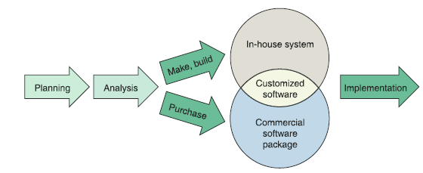
In-House Software Development Options (Cont.)
Make or Buy Decision
The choice between developing vs. purchasing often is called a make or buy, or build or buy, decision
The company’s IT department makes, builds, and develops in-house software
A software package is obtained from a vendor or application service provider
FIGURE 7-8 Instead of outsourcing, a company can choose to develop a system in-house, or purchase and possibly customize a commercial package

Slide 14
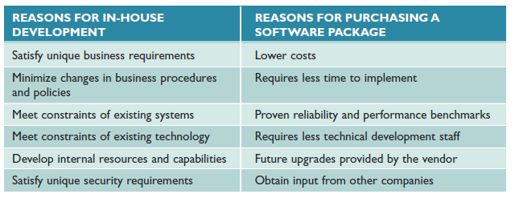
In-House Software Development Options (Cont.)
FIGURE 7-10 Companies consider various factors when comparing in-house development with the purchase of a software package

Slide 15
Overview of Object-Oriented Analysis (Cont.)
Developing Software In-House
Satisfies unique business requirements
Because no commercial software package can meet their unique business requirements
Minimizes changes in business procedures and policies
Installing a new software package almost always requires some degree of change in how a company does business
Meets constraints of existing systems
Any new software installed must work with existing systems

Slide 16
Overview of Object-Oriented Analysis (Cont.)
Developing Software In-House (Cont.)
Meets constraints of existing technology
The new system must work with existing hardware and legacy systems
Develops internal resources and capabilities
Develop and train an IT staff that understands the organization’s business functions and information support needs

Slide 17
Overview of Object-Oriented Analysis (Cont.)
Purchasing a Software Package
Lower costs
A software package almost always is less expensive than in-house
Requires less time to implement
Packages have already been designed, programmed, tested, and documented
Proven reliability and performance benchmarks
Major problems probably have been detected already and corrected by the vendor

Slide 18
Overview of Object-Oriented Analysis (Cont.)
Purchasing a Software Package (Cont.)
Requires less technical development staff
Companies can reduce the number of programmers and systems analysts on the IT staff
Future upgrades provided by the vendor
Improvements and enhancements included in a new version or release
Input from other companies
You can contact users in other companies to obtain their input and impressions

Slide 19
Overview of Object-Oriented Analysis (Cont.)
Customizing a Software Package
Purchase a basic package that vendors will customize to suit your needs
Negotiate directly with the software vendor to make enhancements to meet your needs by paying for the changes
Purchase the package and make your own modifications (if this is permissible under the terms of the software license)

Slide 20
Overview of Object-Oriented Analysis (Cont.)
Creating User Applications
User application
Using Microsoft Office
User interface
Screens, commands, controls, and features that enable users to interact more effectively with the application
Help desk or information center (IC)
Responsible for providing user support
Screen and report generators
Allow users to design their own data entry forms and reports
Read-only properties
Make sure that users view, but not change, the data

Slide 21
The Systems Analyst’s Role
The decision to develop software in-house requires more participation from the systems analyst than outsourcing or choosing a commercial package
Evaluation and selection of alternatives is not a simple process
Systems analysts often work as an evaluation and selection team
Primary objective is to eliminate system alternatives that will not meet requirements, rank the alternatives that are feasible, and present the viable alternatives to management for a final decision

Slide 22
Analyzing Cost and Benefits
Financial Analysis Tools (see Part C of the Systems Analyst’s Toolkit)
Payback analysis
Determines how long it takes an information system to pay for itself through reduced costs and increased benefits
Return on investment (ROI)
Percentage rate that compares the total net benefits (the return) received from a project to the total costs (the investment) of the project
Net present value (NPV)
Total value of the benefits minus the total value of the costs

Slide 23
Analyzing Cost and Benefits (Cont.)
Cost-Benefit Analysis Checklist
List each development strategy being considered
Identify all costs and benefits for each alternative (Be sure to indicate when costs will be incurred and benefits realized)
Consider future growth and the need for scalability
Include support costs for hardware and software
Analyze various software licensing options, including fixed fees and formulas based on the number of users or transactions
Apply the financial analysis tools to each alternative
Study the results and prepare a report to management

Slide 24
The Software Acquisition Process
Step 1: Evaluate the Information System Requirements
Identify key features
Consider network and Web-related issues
Estimate volume and future growth
Specify hardware, software, or personnel constraints
Prepare a request for proposal or quotation

Slide 25
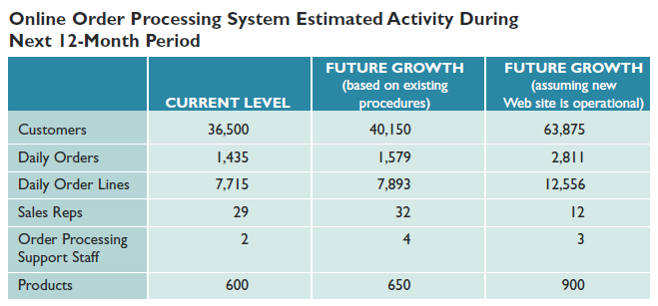
The Software Acquisition Process (Cont.)
FIGURE 7-15 Volume estimates for an order processing system showing current activity levels and two forecasts: one based on the existing order processing procedures and another that assumes a new Web site is operational

Slide 26
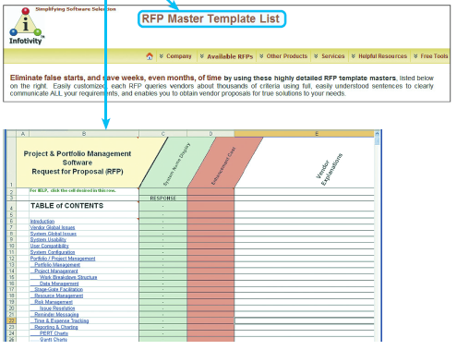
The Software Acquisition Process (Cont.)
FIGURE 7-16 Infotivity Technologies offers a ready-made RFP template that allows a wide range of reponses and comments

Slide 27
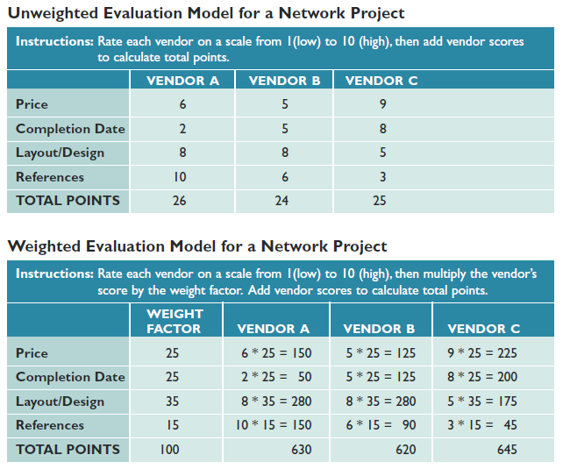
The Software Acquisition Process (Cont.)
FIGURE 7-17 The three vendors have the same initial ratings, but the two evaluation models produce different results. In the unweighted model at the top of the figure, vendor A has the highest total points. However, after applying weight factors, vendor C is the winner, as shown in the model at the bottom of the figure

Slide 28
The Software Acquisition Process (Cont.)
Step 2: Identify Potential Vendors or Outsourcing Options
The Internet is a primary marketplace
Another approach is to work with a consulting firm
Another valuable resource is the Internet bulletin board system that contains thousands of forums, called newsgroups

Slide 29
The Software Acquisition Process (Cont.)
Step 3: Evaluate the Alternatives
Existing users –
Obtain feedback and learn about their experiences
Application testing –
Is it possible for users in your organization to try the product?
Benchmarking –
Measures the time a package takes to process a certain number of transactions
Match each package against the RFP features and rank the choices

Slide 30
The Software Acquisition Process (Cont.)
Step 4: Perform Cost-Benefit Analysis
Identify and calculate TCO for each option you are considering
When you purchase software, what you are buying is a software license
If you purchase a software package, consider a supplemental maintenance agreement

Slide 31
The Software Acquisition Process (Cont.)
Step 5: Prepare a Recommendation
Evaluate and describe alternatives, together with the
Costs
Benefits
Advantages
Disadvantages of each option
Submit a formal system requirements document and deliver a presentation

Slide 32
The Software Acquisition Process (Cont.)
Step 6: Implement the Solution
Implementation tasks will depend on the solution selected
Before the new software becomes operational, you must complete all implementation steps, including loading, configuring, and testing the software; training users; and converting data files to the new system’s format

Slide 33
Completion of Systems Analysis Tasks
System Requirements Document
Also called a software requirements specification
Contains the requirements for the new system, describes the alternatives that were considered, and makes a specific recommendation to management
Like a contract
Format and organize it so it is easy to read and use

Slide 34
Completion of Systems Analysis Tasks (Cont.)
Presentation to Management (review the suggestions in Part A of the Systems Analyst’s Toolkit)
Summarize the primary viable alternatives
Explain why the evaluation and selection team chose the recommended alternative
Allow time for discussion and for questions and answers
Obtain a final decision from management or agree on a timetable for the next step in the process

Slide 35
Completion of Systems Analysis Tasks (Cont.)
Presentation to Management
Depending on their decision, your next task as a systems analyst will be one of the following
Implement an outsourcing alternative
Develop an in-house system
Purchase or customize a software package
Perform additional systems analysis work
Stop all further work

Slide 36
Transition to Systems Design
Preparing for Systems Design
Systems design requires accurate documentation. Must provide detailed specifications for output, input, data, processes
Logical and Physical Design
Logical defines what must take place, not how it will be accomplished
The physical design like a set of blueprints for the actual construction of a building

Slide 37
Chapter Summary
A new trend views Software as a Service (SaaS), rather than a product
Traditional systems
must function in various hardware and software environments
be compatible with legacy systems
operate within the constraints of company networks and desktop computing capability
Web 2.0 is fueling the expansion of information sharing, user collaboration, and social-networking applications such as Twitter, LinkedIn, and Facebook

Slide 38
Chapter Summary (Cont.)
Companies create in-house systems
Commercial software packages can be an attractive alternative
Generally costs less, takes less time to implement, has a proven track record, and is upgraded frequently
The systems analyst’s role in the software development process depends on the specific development strategy

Slide 39
Chapter Summary (Cont.)
The most important factor in choosing a development strategy is total cost of ownership (TCO)
Financial analysis tools include:
Payback analysis
Return on investment (ROI)
Net present value (NPV)

Slide 40
Chapter Summary (Cont.)
Acquiring software involves a series of steps:
Evaluate the system requirements
Consider network and Web-related issues
Identify potential software vendors or outsourcing options
Evaluate the alternatives
Perform cost-benefit analysis
Prepare a recommendation
Implement the solution

Slide 41
Chapter Summary (Cont.)
The system requirements document is the deliverable, or end product, of the systems analysis phase.
Details all system requirements and constraints
Recommends the best solution,
Provides cost and time estimates for future development work

